Slide 2
My own story
Very aggressive atheist as a teenager
Science could answer everything!
No need for God – no room for God
Went up to Oxford in 1971 to study Chemistry
Major rethink!
A sense of wonder at nature . . .

Slide 3
Faith is just a fact of life
Faith is not irrational. It just goes beyond the limits of reason.
Terry Eagleton: “We hold many beliefs that have no unimpeachably rational justification, but are nonetheless reasonable to entertain.”
Julia Kristeva: “Whether I belong to a religion, whether I be agnostic or atheist, when I say ‘I believe’, I mean ‘I hold as true’.”

Slide 4
José Ortega y Gasset (1883-1955)
Scientific truth is characterized by its precision and the certainty of its predictions. But science achieves these admirable qualities at the cost of remaining on the level of secondary concerns, leaving ultimate and decisive questions untouched.

Slide 5
José Ortega y Gasset (1883-1955)
We are given no escape from ultimate questions. In one way or another they are in us, whether we like it or not. Scientific truth is exact, but it is incomplete.

Slide 6
John Donne
“‘Tis all in pieces, all coherence gone.”
The Anatomy of the World

Slide 7
Sir Peter Medawar
“Only humans find their way by a light that illuminates more than the patch of ground they stand on.”
Peter B. Medawar and Jean Medawar. The Life Science: Current Ideas of Biology. London: Wildwood House, 1977, 171.

Slide 8
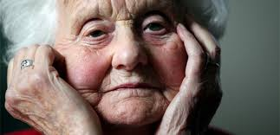
Mary Midgley
“For most important questions in human life, a number of different conceptual tool-boxes always have to be used together.”

Slide 9
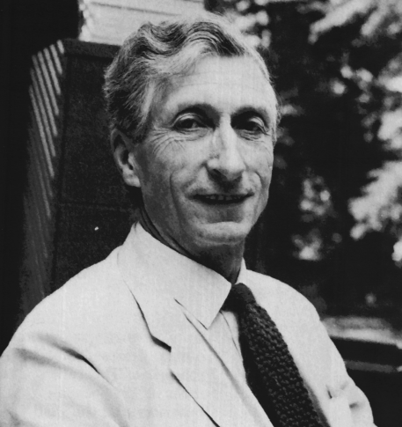
Charles Coulson (1910-74)
Oxford’s first Professor of Theoretical Chemistry

Slide 10
Charles Coulson (1910-74)
Best known for his Science and Christian Belief (1955) – still worth reading
Fundamental coherence of nature and faith
Rejection of idea of “God of the gaps”
Christianity provides an explanatory vision that explains the success of science
Need multiple perspectives
Coulson was a mountaineer in his spare time . . .

Slide 12
Ben Nevis

Slide 13
Ben Nevis
Ben Nevis looks different when seen or approached from different directions.
“A partial knowledge can be supplemented by sharing with others in the descriptions which they give us.”
“It is only the man who cannot, or will not, look at it from more than one viewpoint who claims an exclusive authority for his own position.”

Slide 14
Mary Midgley
Multiple maps of reality
None good enough on its own
Example: an aquarium

Slide 15
Mary Midgley
We cannot see it as a whole from above, so we peer in at it through a number of small windows ... We can eventually make quite a lot of sense of this habitat if we patiently put together the data from different angles. But if we insist that our own window is the only one worth looking through, we shall not get very far.

Slide 16
Another approach
Different levels of explanation
Reality is complex
Has many levels
Frank H. Rhodes on boiling a kettle

Slide 17
Frank H. T. Rhodes
Now these are different answers . . . But both are true, both are complementary and not competitive. One answer is appropriate within a particular frame of reference, the other within another frame of reference. There is a sense in which each is incomplete without the other.

Slide 18
Against reductionism!
Human beings have multiple levels of existence!
Each level helps us understand the complexity of human nature.
The physicist will tell us that we are made of atoms and molecules.
She’s right. But she’s wrong if she adds the ridiculous word “just.”

Slide 19
Against reductionism!
The chemist will tell us about chemical reactions leading to food being converted to energy.
The physiologist will tell us about the functions of the various organs that make up the human body.
These are all true. Yet we transcend all of these levels of description (or perspectives)!
If humanity is defined by anything, it is not by what we find at the bottom of the ladder, but at the top.

Slide 20
Sir Peter Medawar
“Questions that science cannot answer and that no conceivable advance of science would empower it to answer.”
Peter Medawar, The Limits of Science. Oxford: Oxford University Press, 1987, 66.

Slide 21
Carl Sagan and the “Pale Blue Dot”
One of the world’s most famous photographs was taken in 1990 from the Voyager space probe during its mission to the outer solar system.
12 years after its launch, it reached the planet Saturn.
Carl Sagan suggested the probe’s cameras should send back an image of earth, seen from a distance of about 6 billion kilometres.

Slide 22
Carl Sagan and the “Pale Blue Dot”
A “pale blue dot”
A “lonely speck in the great enveloping cosmic dark”

Slide 23
The perspective of faith
Psalm 8:
When I look at your heavens, the work of your fingers, the moon and the stars that you have established; what are human beings that you are mindful of them, mortals that you care for them? (Psalm 8:3-4)

Slide 24
Concluding
Science and faith can enrich each other
Both offer part of a bigger picture
C. S. Lewis:
“I believe in Christianity as I believe that the Sun has risen, not only because I see it, but because by it, I see everything else.”

